Slide 1
Road traffic Injuries in Australia
Wilson To Wee Sen (100076027)

Slide 2
Background
Road traffic accidents are one of the world’s largest public health and injury prevention problems.
Australia has seen over 190,000 fatalities since an accurate car record commenced in 1925.

Slide 3
Motivation
To gain more understanding about road traffic injuries
To understand the rate of road traffic injuries by different type of data
Encourage reader to explore and manipulate data to uncover other factor that cause road traffic injuries

Slide 4
Data source and data type
Data collected from Australia Government, department of infrastructure, regional development and cities.
Age group data collected from National Road Safety Strategy
The data set is in excel file type.

Slide 5
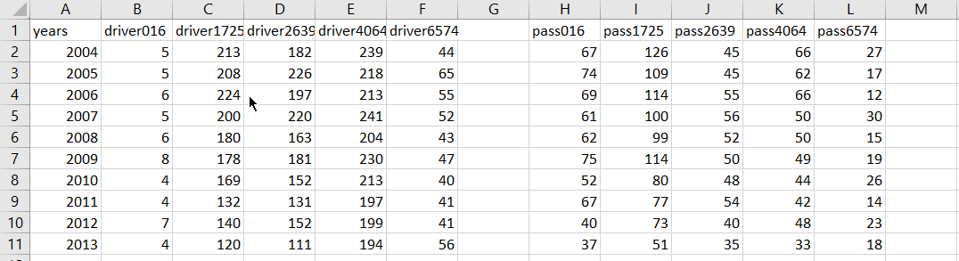
Data processing
Filter the data from excel file and convert to csv file
Attributes of data: years, number of road traffic injuries, age groups, genders, and states.

Slide 6
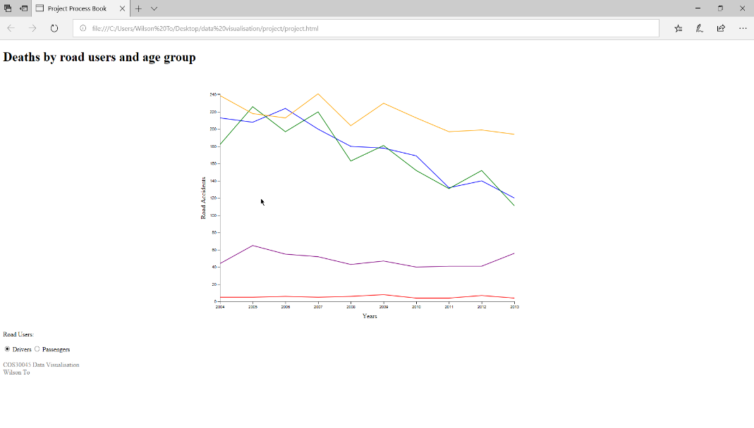
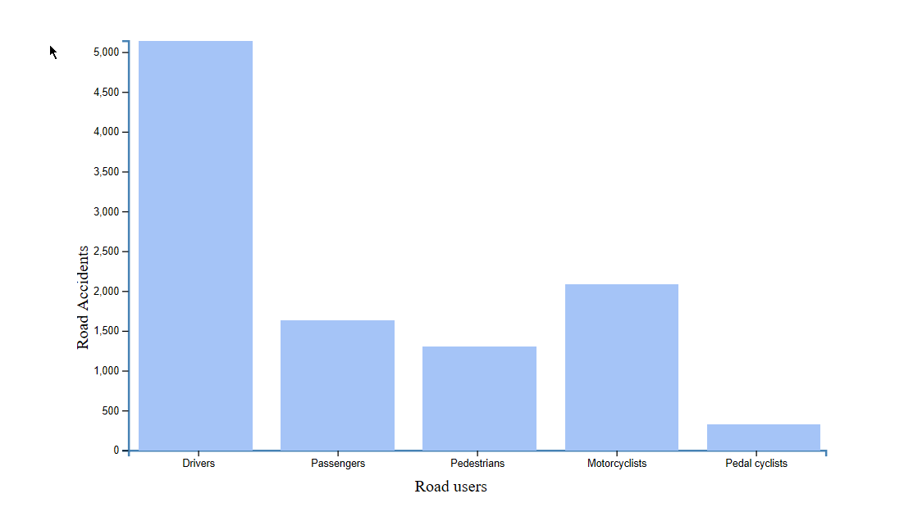
Visualisation design
2 line charts and 1 bar chart
Lines represents the number of injuries and colors represent different age groups
The height of the bar indicate the number of injuries of road users.

Slide 7
Demonstration and questions

